Slide 1
BIA
Architecture
The Framework v3

Slide 2







Modules Overview
Already 5 years of innovation
a growing community
Graphic unit
Safran Graphic Chart,
themes light and dark
Code Secure
Validate by secure code at every deployment
Mobile
Responsive Web design
Multilingual
French, English, Spanish, German, date format ...
Code generator
Quick start and adaptable
Integrated reports
SSRS, PowerBi, Hightchart…
Entity framework
No SQL
Text to speech
Multilingual voice module
Hangfire
Matomo
Statistic usage
Automatic deployment.
Fast and secure
A continuous evolution

Slide 3








Run overview
Example of 2 applications design with the BIA Framework:
Appli 1 : user prepare data. It is host in a central datacenter
Appli 2 : user use the prepared data in an plant. The application is hosted on site to never stop the production
Several Identification are possible:
Windows integrated
Keycloak
Several authorization are possible :
AD Groups
Intern fine grant system
External tools ….
AD
Other Servers
<FILE SERVER>
Appli 1
DataCenter
User Appli 1
<WEB SERVER>
Appli 1
CIFS
CIFS
<APP SERVER>
Appli 1
<FRONT ANGULAR>
Appli 1
Https
SQL
SQL
< DB SERVER >
Appli 1
SSIS Server
Plant
<WEB SERVER> Appli 2
<FILE SERVER> Appli 2
User eTI
<FRONT ANGULAR>
Appli 2
SQL
< DB SERVER > Appli 2

Slide 4
Connector overview
Example of 2 applications design with the BIA Framework:
Appli 1 : user prepare data. It is host in a central datacenter
Appli 2 : user use the prepared data in an plant. The application is hosted on site to never stop the production
Several Identification are possible:
Windows integrated
Keycloak
Several authorization are possible :
AD Groups
Intern fine grant system
External tools ….
AD
Other Servers
<FILE SERVER>
Appli 1
DataCenter
User Appli 1
<WEB SERVER>
Appli 1
CIFS
CIFS
<APP SERVER>
Appli 1
<FRONT ANGULAR>
Appli 1
Https
SQL
SQL
< DB SERVER >
Appli 1
SSIS Server
Plant
<WEB SERVER> Appli 2
<FILE SERVER> Appli 2
User eTI
<FRONT ANGULAR>
Appli 2
SQL
< DB SERVER > Appli 2

Slide 5

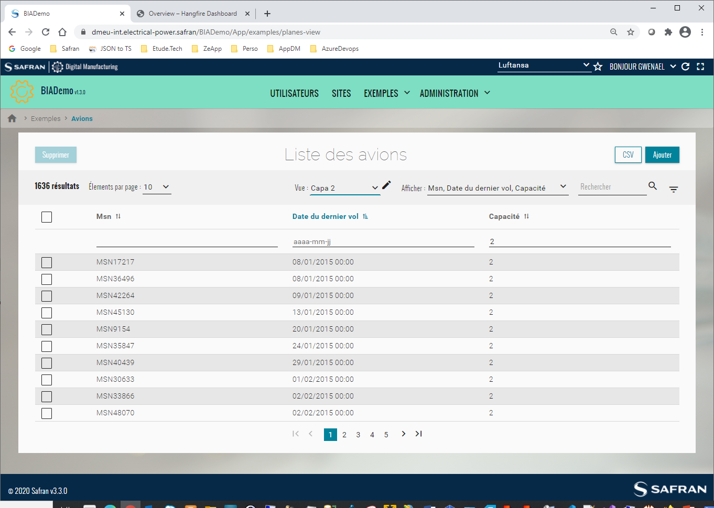
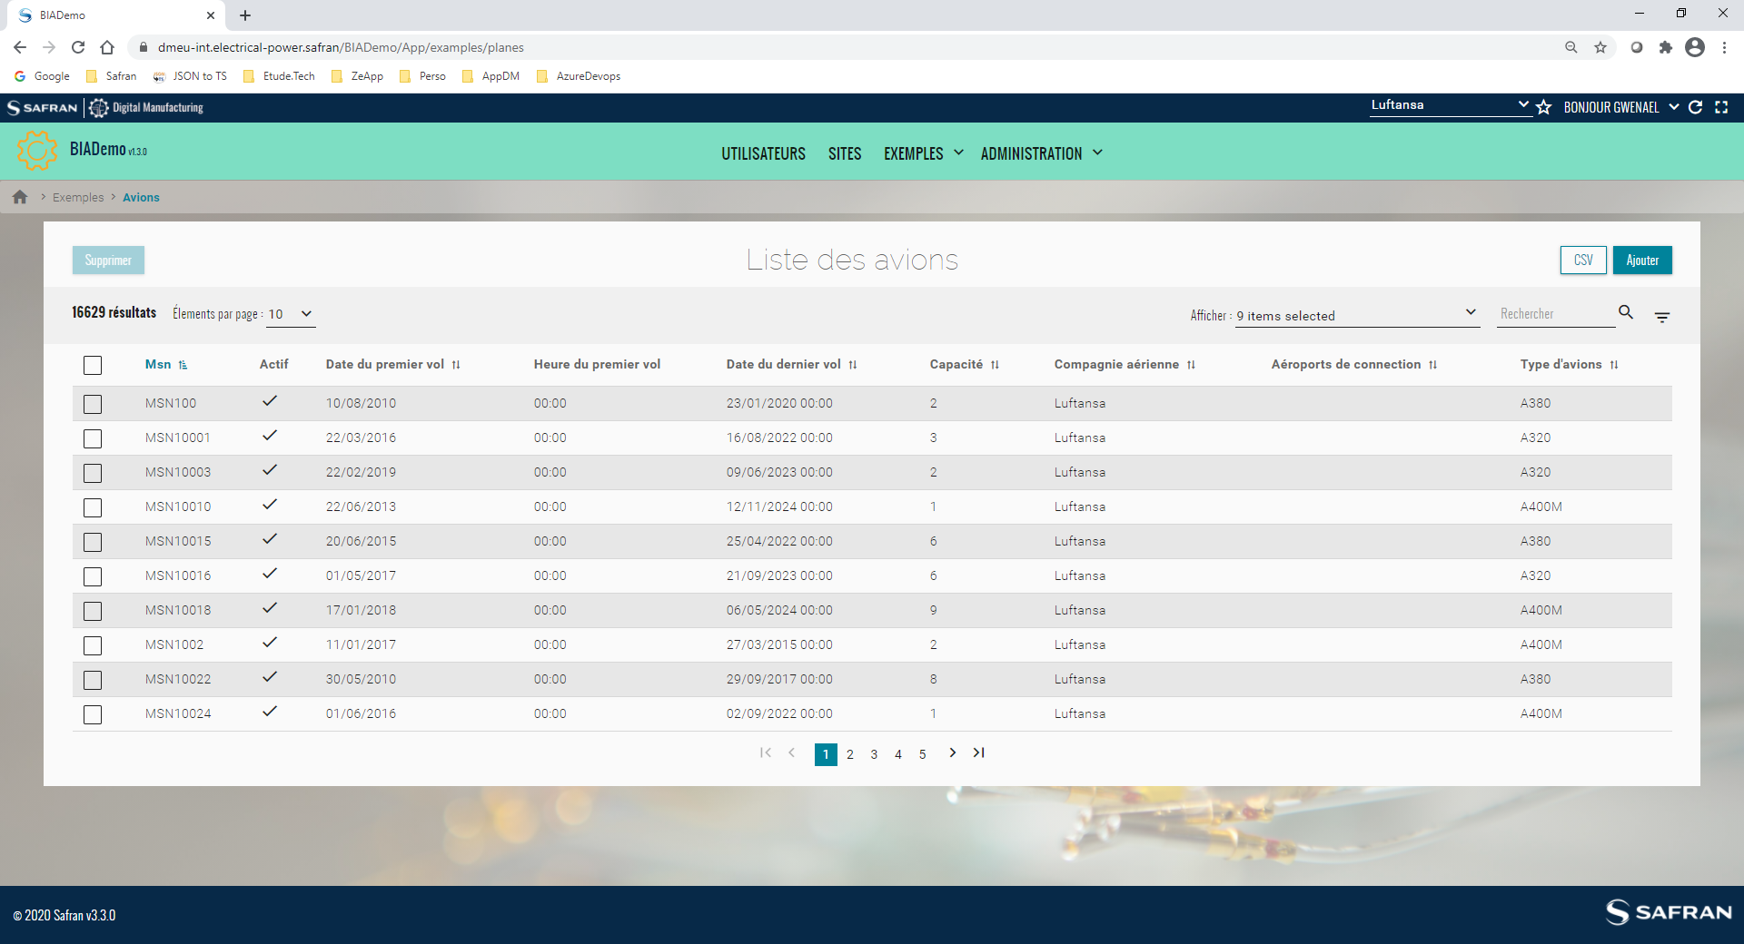
CRUD Overview
CRUD can be easily generated with powerful features:
3 Edit mode : in popup, in full page or inline in the table
Create and select views: select columns, filter, search.
Apply action on selected elements
SignalR synchronization = it do not need an user action to see modification done by other users
Simple or advanced filters
Export data in different format….

